Slide 1
Health-LLM: Large Language Models for Health Prediction via Wearable Sensor Data
Yubin Kim¹, Xuhai Xu¹, Daniel McDuff², Cynthia Breazeal¹, Hae Won Park¹
(¹Massachusetts Institute of Technology, ²Google Research)
Presenter: Shovito Barua Soumma
Date: July 17, 2024
Archive April 2024, [20 Citations as today]
Code Base: https://github.com/mitmedialab/health-llm
Notes:
Presenter: Shovito Barua Soumma

Slide 2
Introduction
a framework in the healthcare domain that aims to bridge the gap between pre-trained knowledge in current LLMs and consumer health problems.
Multimodal Time series sensor data
Challenge:
Unlike static text, this data presents unique challenges for LLMs due to its high dimensionality, non-linear relationships, and continuous nature, requiring them to understand not only individual data points but also their dynamic patterns over time.
There are some prior works but those did not use physiological and behavioral data time series data → untested due to challenges of non-linguistic data

Slide 3
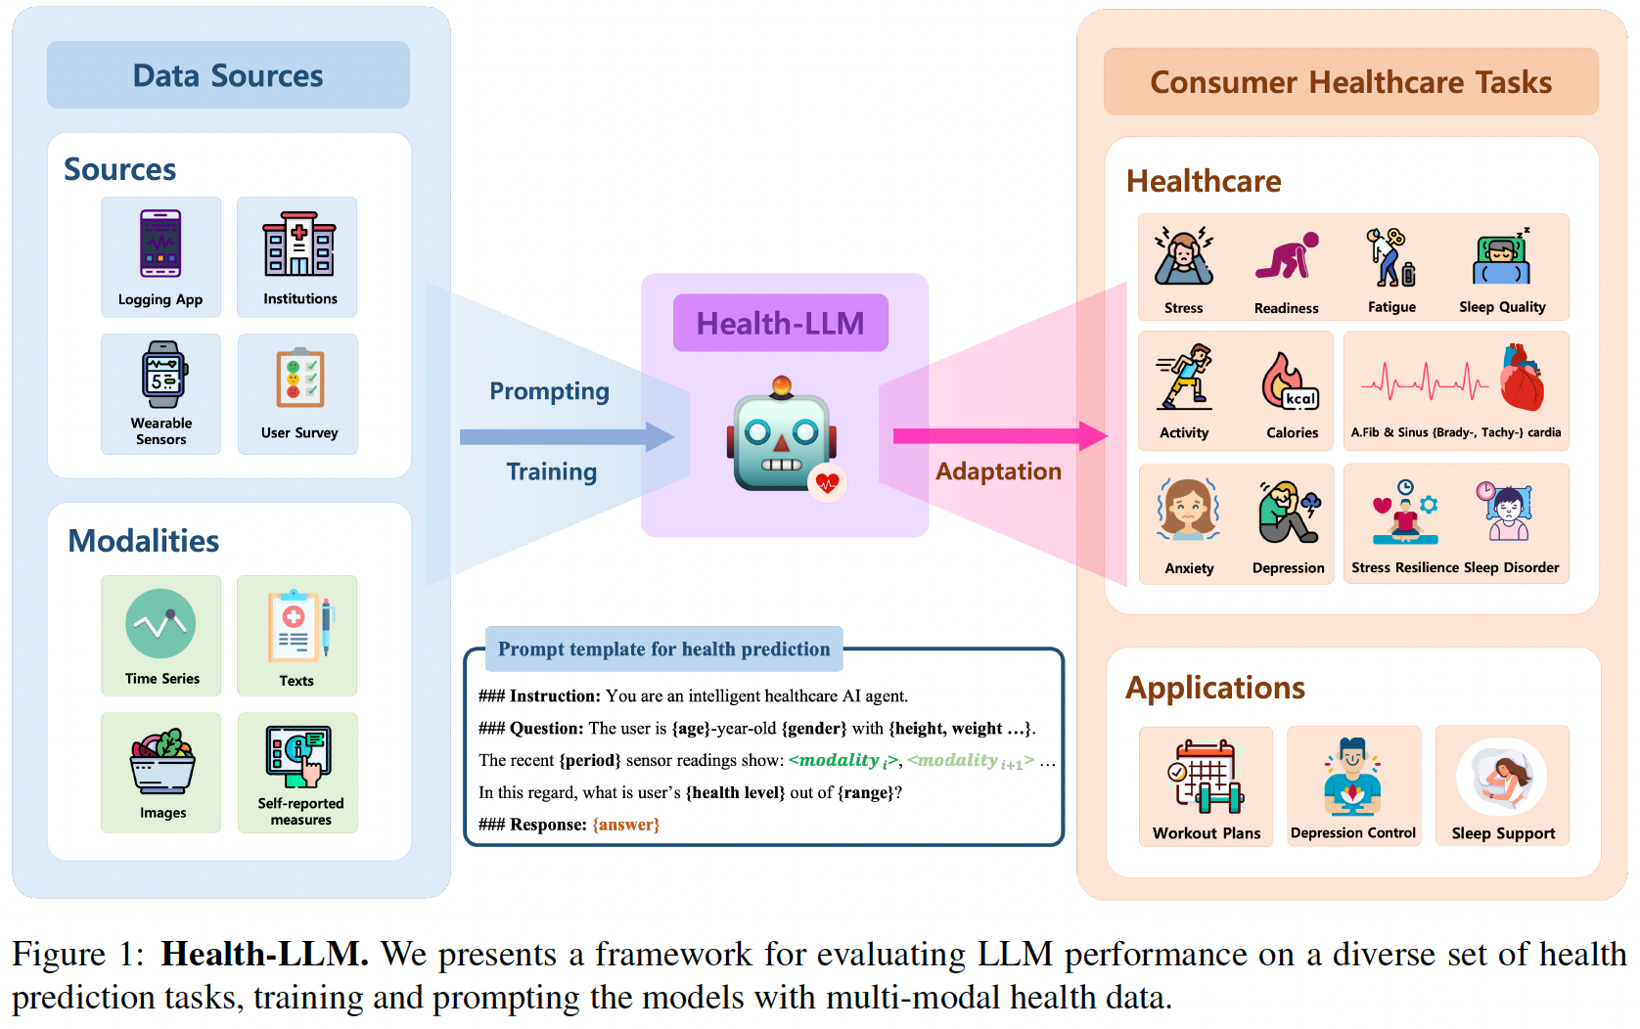
Introduction
Health-LLM
Goal: Health status prediction [mental health, activity tracking, sleep, carido]
Experiments include:
Zero shot prompt
Few shot + Chain of Thought + Self consistency
Instructional Finetuning
8 public datasets
Notes:
The tasks cover five areas:
Mental Health (MHealth): Predicting stress levels and resilience based on activity data and self-reported mood.
Activity: Assessing readiness for exercise and fatigue from physiological data.
Metabolism: Estimating calories burned from the intensity of physical activities.
Sleep: Predicting sleep quality and identifying potential sleep disorders from sleep patterns.
Cardiovascular: Detecting conditions like atrial fibrillation or sinus abnormalities from heart rate data.

Slide 4
Introduction
The paper finds that by giving these LLMs additional context – meaning more detailed information about the person's health background and the specifics of their data – the models can make more accurate predictions.
For example, telling the model that someone's heart rate varies a lot during sleep could help it determine if that person is at risk for a sleep disorder.

Slide 5
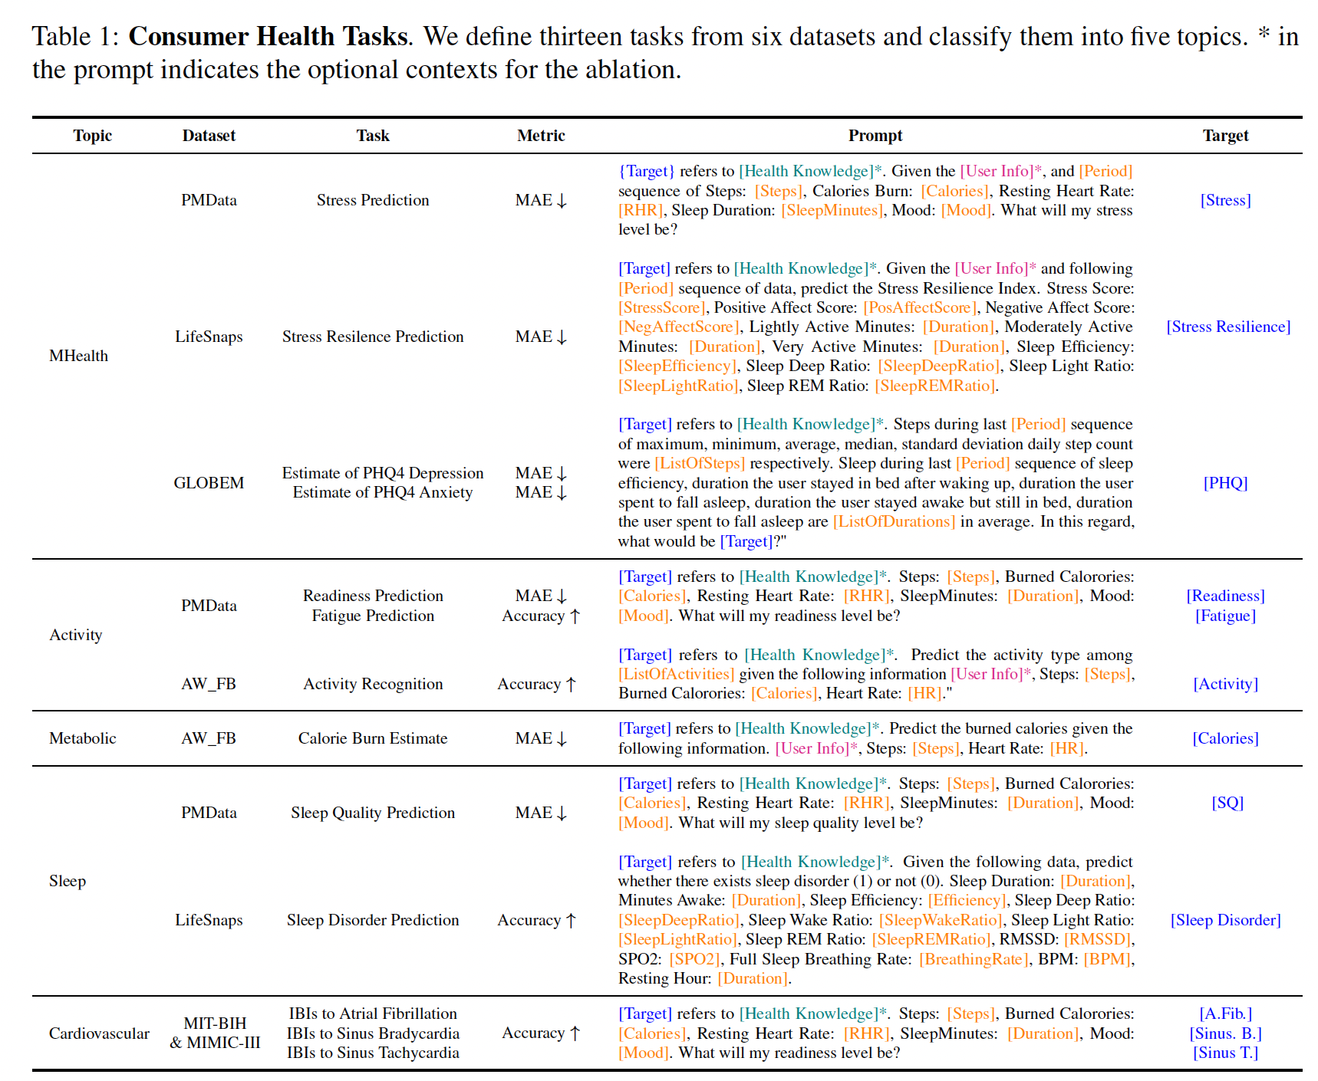


Slide 6
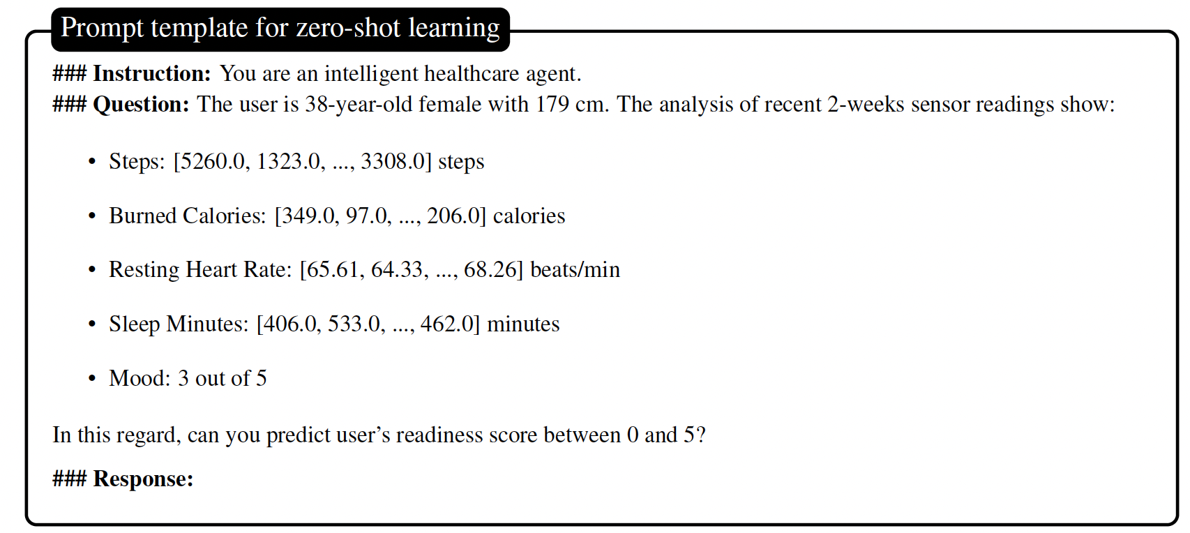
Method: Zero-shot
This creates a straightforward question for the LLM using summarized data from wearable sensors (basic prompt: bs) , asking for a health prediction. The model must answer based on its existing knowledge, without any specific training on the task.
Comprehensive Zero shot (No fine tune + Providing some context) with context enhancement
User Context (uc): Personal details about the user, such as age, gender, height, etc., are included to provide the LLM with more background information that could influence the health outcomes.
Health Context (hc): Specific definitions and explanations related to health (like what a readiness score signifies) are given to supply the model with domain-specific knowledge that might not be part of its original training.
Temporal Context (tc): Instead of summarizing the sensor data over a period, detailed time-series data (like exact steps at different times) are used to evaluate the importance of patterns over time.
All (all): All the contexts are combined into a single prompt to give the model the most comprehensive view.

Slide 7
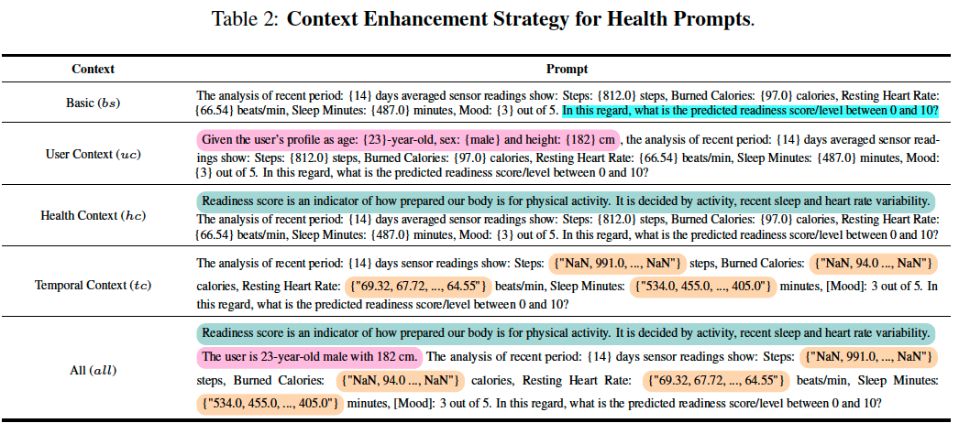
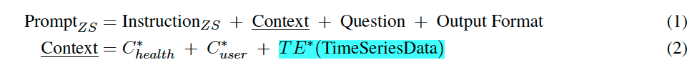


Method: Zero-shot

Slide 8
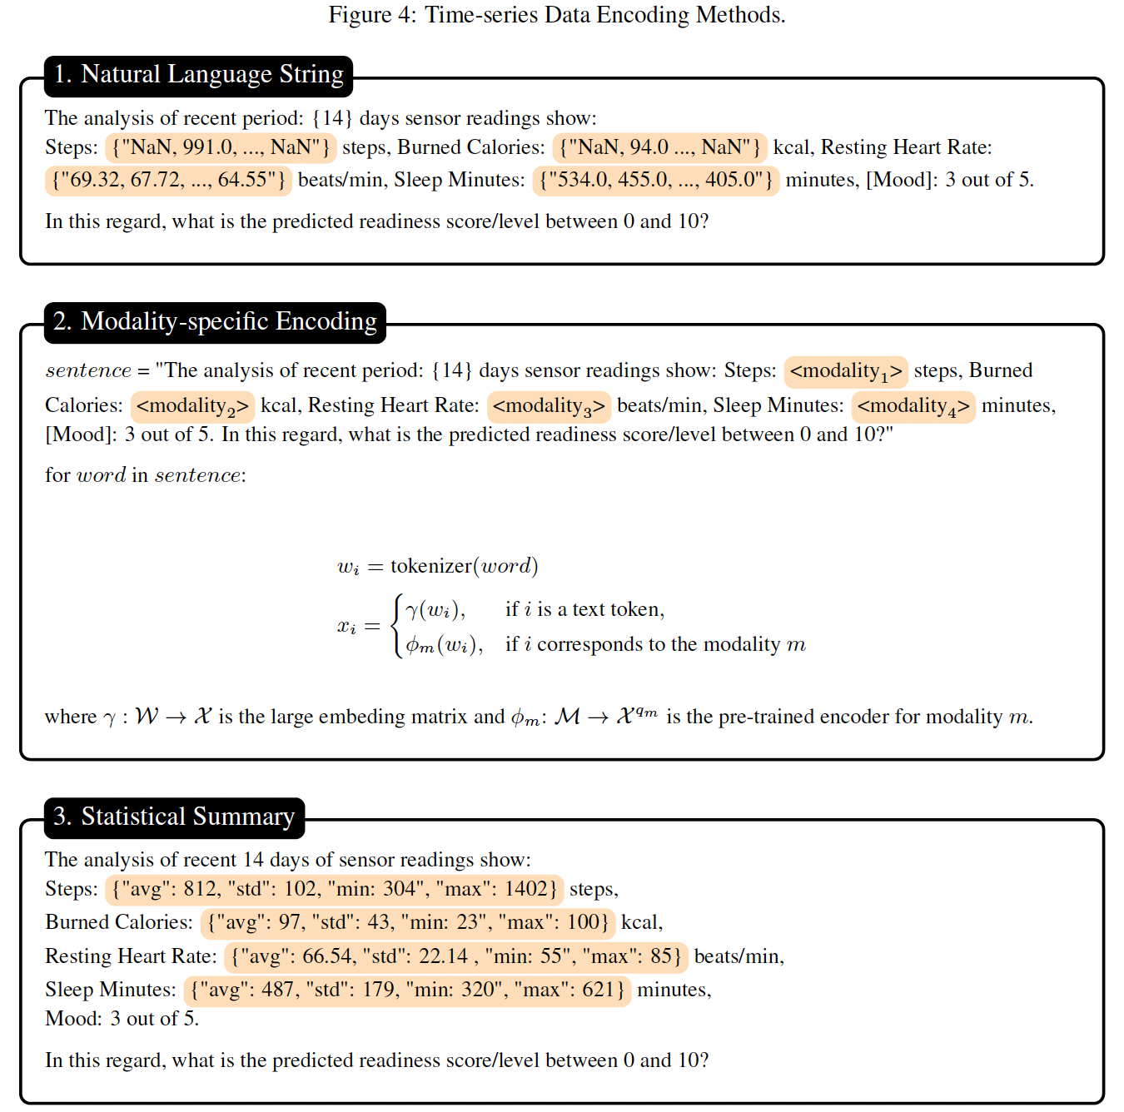
Temporal Encoding
Time series data encodes into textual format
Natural Language String: Time-series data is directly turned into a string of text that mimics natural language. For example, if the data points are the number of steps taken each day over two weeks, the natural language string might look something like "Day 1: 8000 steps, Day 2: 7500 steps, ..., Day 14: 9000 steps". Missing values : "NaN" (which stands for "Not a Number")

Slide 9

Temporal Encoding
Time series data encodes into textual format
2. Modality-specific Encoding: This method uses special pre-trained encoders to transform each type of non-text data (like heart rate or step count) into a format/latent space that the language model can process. Think of it like translating French into English before giving it to someone who only understands English. It's more complex and computationally demanding because each type of data might need a different "translator".

Slide 10
Temporal Encoding
Time series data encodes into textual format
3. Statistical summary
Rather than using the raw data, this approach summarizes it with statistics. For instance, instead of daily steps over two weeks, it might provide an average: "The average steps over the last 14 days is 8500, with a standard deviation of 500." This method is compact, but it can lose detailed patterns in the data, such as how the step count changes from day to day.

Slide 11
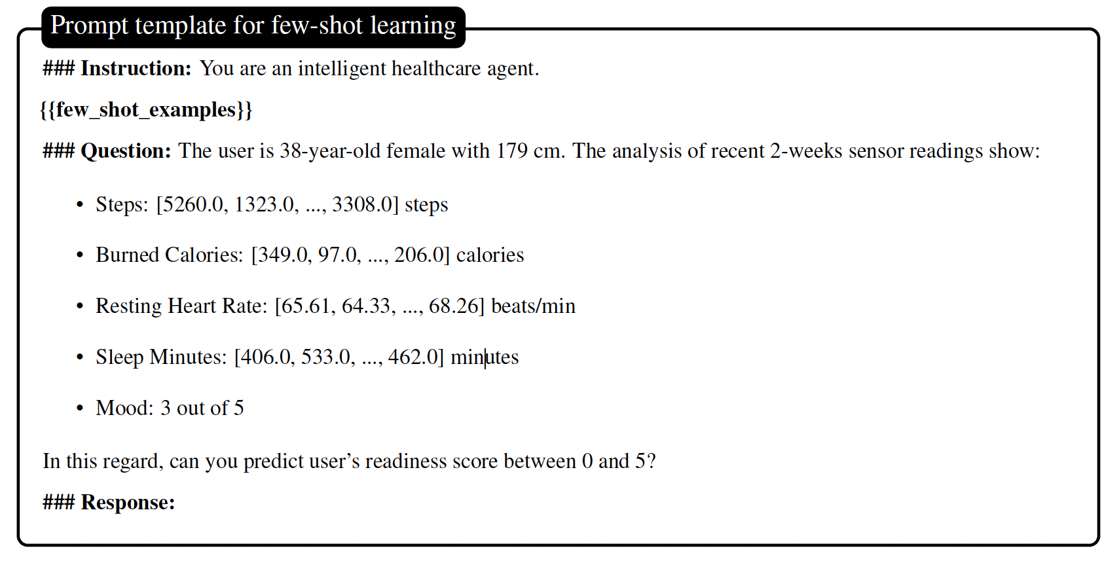
Method: Few-shot (3 shot)
The model gets a little help. It's shown a few specific examples of the task at hand, which are like mini-tutorials that guide the model on how to tackle similar problems. This approach is enhanced by:
Chain-of-Thought (CoT): This encourages the model to show its thought process, breaking down the problem step-by-step like a human would.
Self-Consistency (SC): This ensures that when the model tries to solve similar problems, it does so consistently.

Slide 12
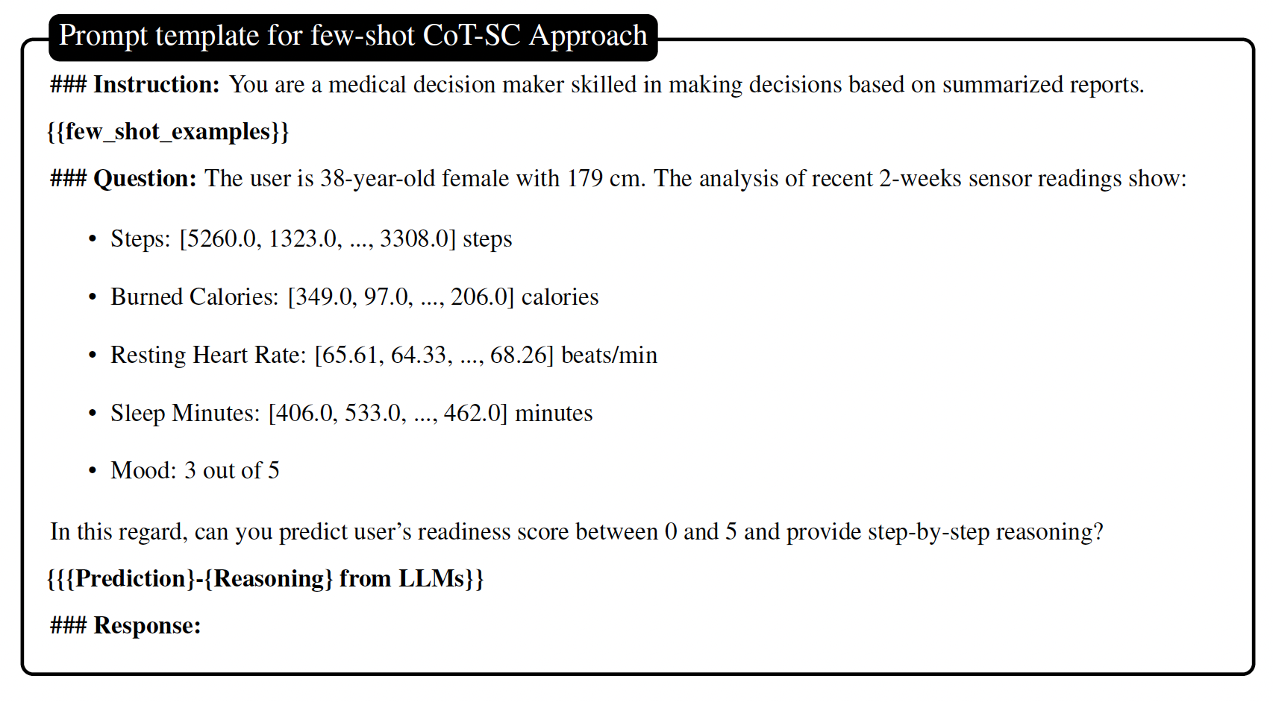
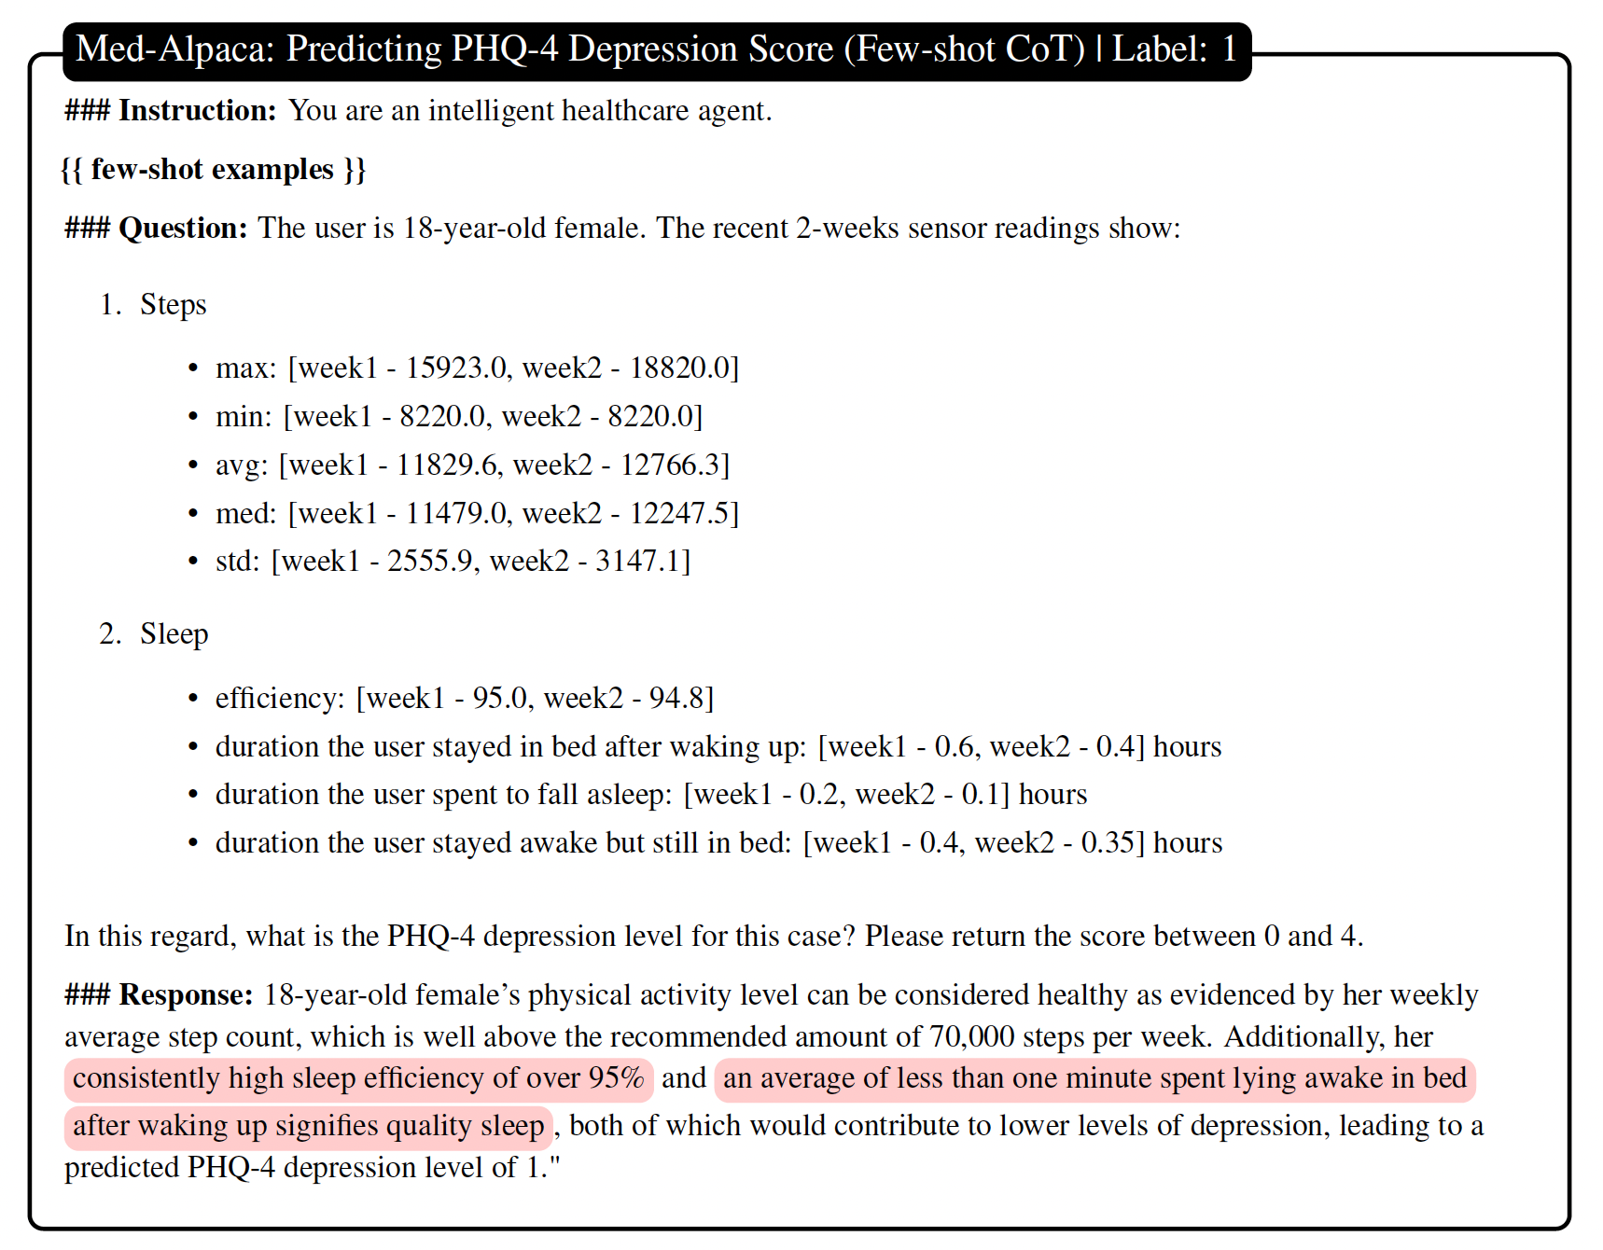

Slide 13
Method: instruction tuning
instruction tuning
All parameters of a pre-trained model are fine-tuned on a target task.
Allows models to gain a deeper understanding of physiological terms, mechanisms, and contexts, thus enhancing their ability to generate accurate and contextually relevant responses.
parameter efficient fine tuning (PEFT)
Instead of fine tuning all parameters, methods such as LoRA train a small amount of parameters by injecting a trainable low-rank matrix into each layer of a pre-trained model

Slide 14
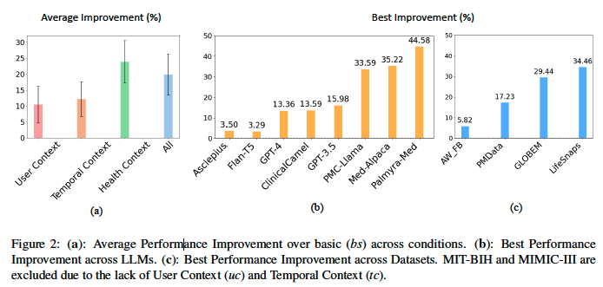
Results

